Slide 1
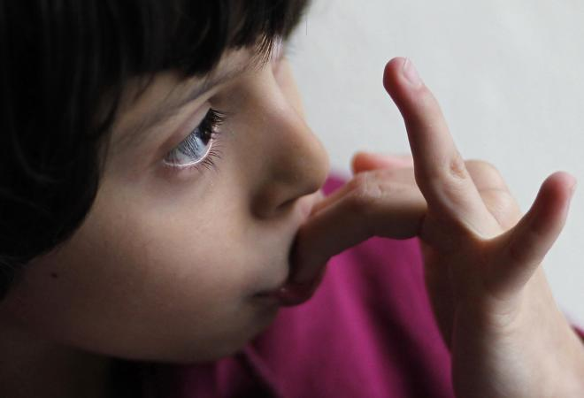
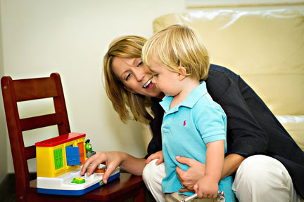
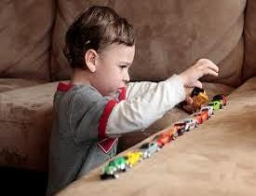
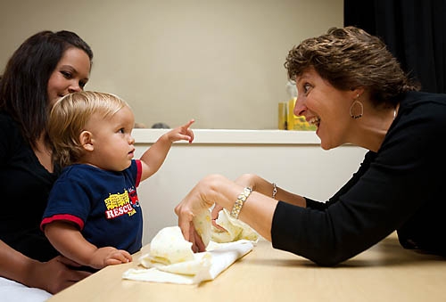
ASD and the DSM-V
Information for School-Based Professionals
March 2, 2016
Presenters
Debby Greene
greened@pps.net
Brad Hendershott
bhender1@pps.net

Slide 2
Criteria Medical
DSM-V: specific, uses algorithm (3/3, 2/4)
No additional requirements
Process
Varies widely
Who
Individual clinician or team
Criteria Education
OARs; broader
Four areas
Adverse impact
Needs services
Process
OARs specify
Who
Team with parent; at least one with ASD expertise; SLP
VS
Notes:
key differences between the Oregon ed. Eligibility and medical diag. criteria.
OAR’s: just the four area, no guidance on core features and in what combination beyond the four big areas
DSM: provides an algorithm: must have all three in the social comm domain, and 2 of the 4 in the patterns of beh. domain.
The DSM also helps us understand the latest science on the core features, how they manifest across the spectrum, and in what combinations they can occur to indicate ASD.
The OAR’s criteria are more over lapping, and have some premises not present in DSM V such as: sensory, but not all with ASD have sensory. It splits social and communication.
However, the OAR Procedures are, I believe, excellent and consistent with a lot of best practices recommended in the med. literature.
The OAR criteria is likely to be updated to align with the DSM V

Slide 3
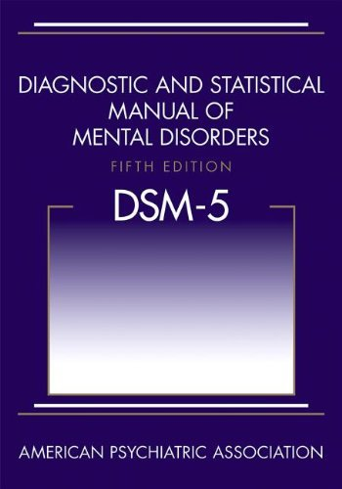
History of Autism and the DSM

Slide 4
History of Autism in the DSMs
DSM l (1952) & ll (1968) - No term “autism” or Pervasive Developmental Disorder
DSM lll (1980) – Pervasive Developmental Disorders (PDD):
Childhood onset PDD
Infantile Autism
Atypical Autism
DSM lll-R (1987) – Pervasive Developmental Disorders (PDD):
PDD-NOS
Autistic Disorder

Slide 5
History of Autism in the DSMs
DSM lV (1994) - – Pervasive Developmental Disorders (PDD):
PDD-NOS
Autistic Disorder
Asperger Disorder
Childhood Disintegrative Disorder
Rett Syndrome
DSM IV-TR (2000) – same diagnoses, text correction for PDD-NOS

Slide 6
Concerns with the DSM-IV
Validity of PDD category
Consistency of some diagnoses (e.g. high-functioning autistic disorder vs. Asperger)
Appropriateness of the use of certain diagnoses (e.g. PDD-NOS as ‘mild neurodevelopmental disorder’, Asperger as ‘odd’ behaviors)
Validity of some diagnoses (e.g. Childhood Disintegrative Disorder)

Slide 7
DSM-V: Merging ASDs into a Single Diagnosis
Autism, Asperger and PDD-NOS collapsed into single diagnosis: Autism Spectrum Disorder
Scientific evidence and clinical practice show that a single spectrum better reflects the symptom presentation.
Separation of ASD from typical development is reliable and valid – separation of disorders within the spectrum is not.
In many states services are only provided for an autism diagnosis – not for PDD-NOS or Asperger.

Slide 8
DSM-V: Merging ASDs into a Single Diagnosis
A single spectrum but significant individual variability:
Severity of ASD symptoms
Pattern of onset
Etiologic factors
Cognitive Abilities (IQ)
Associated Conditions
These details to be described by clinicians with diagnostic specifiers

Slide 9
3 Will Become 2
Social and Communication domains from DSM lV-TR are now merged into the Social Communication domain
Deficits in communication are intimately related to social deficits
De-emphasizes language skills NOT employed in the context of social communication
Corrects for the ‘double counting’ of a behavior in more than one category

Slide 12
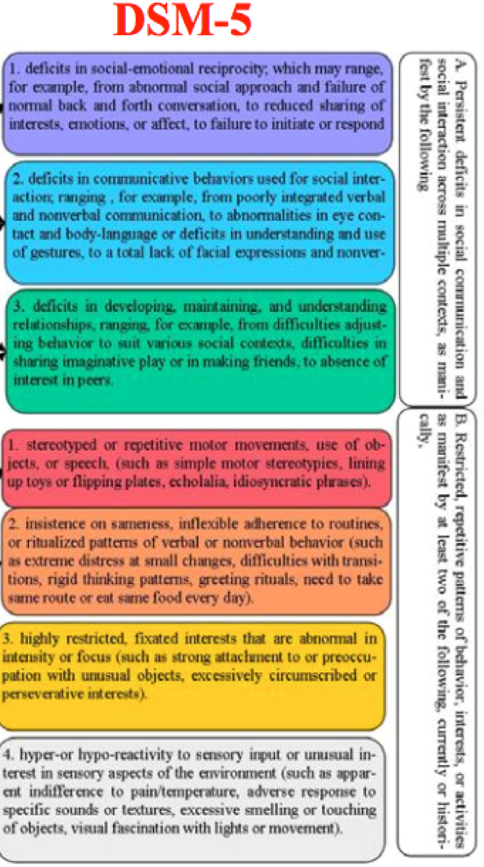
ASD Eligibility
Impairments in communication
Impairments in social interaction
Patterns of behavior, interests or activities that are restricted, repetitive, or stereotypic
Unusual responses to sensory experiences

Slide 13
Other Changes
Inclusion of specifiers such as
“Associated with Known Medical or Genetic Condition or Environmental Factor”
Verbal abilities
Cognitive abilities
Severity of symptoms in each of the two domains
The text description includes symptoms unique to various ages/developmental stages and verbal abilities
Removed “lack of spoken language” from criteria – does this mean that some children with ASD no longer lack speech? No! It simply means the lack of speech/language is not diagnostic/specific to ASD.
Notes:
Brad added green item! I’ll speak to it.

Slide 14
“The revised diagnosis represents a new, more accurate, and medically and scientifically useful way of diagnosing individuals with autism-related disorders.”
“The Neurodevelopmental Work Group believes a single umbrella disorder will improve the diagnosis of children without limiting the sensitivity of the criteria, or substantially changing the number of children being diagnosed.”
-American Psychiatric Association

Slide 15
New Diagnosis: Social (Pragmatic) Communication Disorder
Should not be included in ASD section because it defines a group of individuals with related, but separate symptoms

Slide 16
DSM-V ASD Criteria
A. Persistent deficits in social communication and social interaction across multiple contexts – must have all three deficits in:
social-emotional reciprocity ranging, for example, from abnormal social approach and failure of normal back-and-forth conversation; to reduced sharing of interests, emotions, or affect; to failure to initiate or respond to social interactions.
nonverbal communicative behaviors used for social interaction ranging, for example, from poorly integrated verbal and nonverbal communication; to abnormalities in eye contact and body language or deficits in understanding and use of gestures; to a total lack of facial expressions and nonverbal communication.
Developing and maintaining relationships appropriate to their developmental level ranging, for example, from difficulties adjusting behavior to suit various social contexts; to difficulties in sharing imaginative play or in making friends; to absence of interest in peers.
Notes:
Delete Asperger b/c little difference from autism (no clinical research evidence for separation of hf autism and Asperger’s
Ranging from abnormal social approach and failure of normal back and forth conversations to reduced sharing of interests, emotions, or affect; failure to initiate or respond to social interactions
Range from poorly integrated verbal/nonverbal, abnormal eye contact and body language; deficits in understanding/use of gesture to total lack of facial expression and nonverbal communication
Ranging from difficulties adjusting behavior to various social contexts; to difficulties in sharing, imaginative play or making friends to absence of interest in peers.

Slide 17
B. Restricted, repetitive patterns of behavior, interests, or activities, as manifested by at least two of the following:
Stereotyped or repetitive motor movements, use of objects, or speech (e.g., simple motor stereotypes, lining up toys or flipping objects, echolalia, idiosyncratic phrases).
Excessive adherence to routines, ritualized patterns of verbal or nonverbal behavior, or excessive resistance to change (e.g., extreme distress at small changes, difficulties with transitions, rigid thinking patterns, greeting rituals, need to take same route or eat same food every day).
Highly restricted, fixated interests that are abnormal in intensity or focus (e.g., strong attachment to or preoccupation with unusual objects, excessively circumscribed or perseverative interests).
Hyper-or hypo-reactivity to sensory input or unusual interest in sensory aspects of environment (e.g., apparent indifference to pain/temperature, adverse response to specific sounds or textures, excessive smelling or touching of objects, visual fascination with lights or movement).
*Specify Current Severity (next slide)
.
Notes:
Simple motor stereotypies, lining up toys, flipping objects, echolalia, idiosyncratic phrases
Extreme distress at small changes, difficulties with transitions, rigid thinking patterns, greeting rituals, need to eat same food/take same route each day
Strong attachment or preoccupation with unusual objects, excessively circumscribed or perseverative interests
Apparent indifference to pain/temp, adverse response to specific sounds/textures, excessive smelling or touching objects, fascination with lights or spinning objects

Slide 19
C. Symptoms must be present in early childhood, but may not become fully manifest until social demands exceed limited capacities.
D. Symptoms together limit and impair everyday functioning.
E. Disturbances not better explained by intellectual disability or global developmental delay
Notes:
To make comorbid diagnosis of ASD and ID the social communication should be below that expected for the general developmental level.

Slide 20
Specify if . . .
With or without accompanying ID
With or without accompanying language impairment
Associated with known medical or genetic condition or environmental factor
Associated with another neurodevelopmental, mental, or behavioral disorder
With catatonia

Slide 21
Some conditions are not recognized in the DSM-5 (e.g., Sensory Processing Disorder, Non-verbal Learning Disability)
Many with a non-verbal learning disability will qualify under social communication disorder

Slide 22
The DSM-V and Oregon’s Eligibility Criteria
Oregon Administrative Rules (OARs) specify a criteria and set of procedures, but guidance on what constitutes ASD is loosely defined and out-of-date
Problems with the “four areas”
Social and Communication as distinct categories
DSM-V combines into “Social Communication”
Requirement for sensory impairment when research indicates about 4 out of 5 with confirmed dx. of ASD have sensory characteristics
DSM-V includes sensory under the section “must have 2 of 4” – so sensory difficulties can contribute identification, but lacking sensory won’t preclude diagnosis
Categories in OARs are vague and non-specific to ASD “Impairments in…”
DSM-V specifies core features (lack of emotional reciprocity, non-verbal communication, relationship development) - AND accounts for variability in severity of presentation.

Slide 23
A continuum of impairments from higher to lower…
Deficits in social communication and social interaction:
social-emotional reciprocity ranging, for example, from abnormal social approach and failure of normal back-and-forth conversation; to reduced sharing of interests, emotions, or affect; to failure to initiate or respond to social interactions.
nonverbal communicative behaviors used for social interaction ranging, for example, from poorly integrated verbal and nonverbal communication; to abnormalities in eye contact and body language or deficits in understanding and use of gestures; to a total lack of facial expressions and nonverbal communication.
Developing and maintaining relationships appropriate to their developmental level ranging, for example, from difficulties adjusting behavior to suit various social contexts; to difficulties in sharing imaginative play or in making friends; to absence of interest in peers.
Notes:
Delete Asperger b/c little difference from autism (no clinical research evidence for separation of hf autism and Asperger’s
Ranging from abnormal social approach and failure of normal back and forth conversations to reduced sharing of interests, emotions, or affect; failure to initiate or respond to social interactions
Range from poorly integrated verbal/nonverbal, abnormal eye contact and body language; deficits in understanding/use of gesture to total lack of facial expression and nonverbal communication
Ranging from difficulties adjusting behavior to various social contexts; to difficulties in sharing, imaginative play or making friends to absence of interest in peers.

Slide 24
The DSM-V and Oregon’s Eligibility Criteria
Oregon Administrative Rules (OARs) specify a criteria and set of procedures, but guidance on what constitutes ASD is loosely defined and out-of-date
Problems with the “four areas”
Inconsistent and/or discrepant requirement. Meant to capture “scattering of skills” in ASD and prevent over-identification of students with significant cognitive impairment – problematic and confusing for teams, and it’s never been part of the DSM criteria.
DSM-V simply requires that “Disturbances not better explained by intellectual disability or global developmental delay”
Impairments must be documented over time and/or intensity. Does not factor in that difficulties may be less apparent when younger
DSM-V states that “Symptoms must be present in early childhood, but may not become fully manifest until social demands exceed limited capacities.” – this acknowledges that young children with HFASD may appear “quirky” at 3, but that the gap will often widen as children get older (this is why higher functioning students are often identified later)

Slide 25
The DSM-V and Oregon’s Eligibility Criteria
Other advantages?
The level system
Level three replaces less precise terms “low functioning”, “classic”
Level one replaces “high functioning”, Asperger Syndrome
Level two acknowledged that there are some students that cannot be described as either low or high functioning.
Comment: “High Functioning” has been problematic to some who say it risks under-stating the impact of the disability and the need for support.
While the terms we use are imperfect, we should recognize that a student with ASD who has excellent language but struggles with the social use, versus a student with ASD has little to no functional speech to meet their daily needs.

Slide 26
The DSM-V and Oregon’s Eligibility Criteria
Proposal: The DSM-V can inform the evaluation and eligibility determination, even though we continue to use the Oregon eligibility criteria. We can recognize problems with the current criteria while still operating within it.
Rationale: The DSM-V reflects the best and most current scientific consensus on the combination of observable behaviors that add up to ASD. It provides specificity in those behaviors and the range of severities. In addition, the state is heading in this direction (see: ASD Commission Sub-Committee recommendation)

Slide 27
Utilizing the DSM-V to Inform and Assist with ASD Evaluations
Use of informal checklists
Parent and/or staff interviews
Pre-eligibility analysis to ensure adequate data has been collected, and compare against core features, and coordinate the best way to share the information.
CAUTION: Do not pre-determine eligibility. Honor the process. The team comes together, including the parent, to look at all the data before coming to a conclusion regarding eligibility.
Table in report for organizing and summarizing the presence or absence of core features and adverse impact.
Utilized “in the background” to ensure orientation to core features of ASD

Slide 28
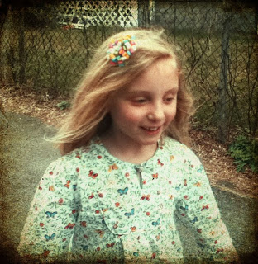
Special Issues
Identification of girls with ASD
5:1 boys to girls
Under-identification
Differences in presentation
The Male Stereotype
Less externalizing behavior
Can mimic appropriate social behavior; blend in
Obsessive interests may appear typical
Fewer repetitive behaviors (flapping, spinning)
Notes:
Many believe that girls are being under-identified, and there’s some research backing this assertion: girls, compared to boys, with ASD showed less severe repetitive/restricted behaviors and comparable deficits in the social and communication domains (Supekar & Menon, 2015)
One study from the Journal of the American Academy of Child and Adolescent Psychiatry found that girls are less likely to be diagnosed with ASD if they don’t have some sort of cognitive delay and externalizing “acting out” or hyperactivity behavioral problems. In addition, other studies have found girls are identified later.
In my experience, most special education referral are made because of behavior. A quirky child who have average intelligence and never acts out can “fly under the radar”, even if they have a host of symptoms associated with ASD: things like obsessive interest in ballroom dance or horses, cognitive rigidity, poor perspective taking.
Other studies have confirmed a gender bias in diagnosis, and a 2011 study confirmed that doctors are more likely to miss autism in girls – some think that we develop a male stereotype for ASD that forms our baseline understand of what ASD looks like.
This is a problem because autism manifests in girls differently than it does in boys. There’s less externalizing behavior. Obsessive interests with girls often don’t stand out the same way as with boys. Many girls are interested in horses, or Harry Potter, but if you dig deeper, the intensity and narrowness will be unusual in girls with ASD. The boy with ASD obsessed with flags of the world, vacuum cleaners, and Latin plant names will stand out more.
Simon Baron Cohen has written that many girls with ASD have learned to cope with social communication deficits by mimicking how peers dress and interact. During direct interactions, girls with HFASD can “fool” clinicians because she’s learned how to cover her difficulties – a very exhausting process some fear contributes to mental health problems. Girls with ASD may be more socially interested and motivated than boys, but they’re unsuccessful in forming developmentally appropriate peer relationships. It turns out that many girls with ASD are interested in imaginative play, sometimes obsessively so. Yet we don’t expect a child with ASD to be playing imaginatively with a doll!
Generally speaking, girls with ASD can be said to have better overall social skills than boys. They blend in better than the boys.
Girls are better at avoiding everyday demands by ignoring them, rather than acting out.
Girls have fewer repetitive behaviors such as rocking and spinning, and less irritated by sensory input.
Conditions may overshadow ASD. Some girls diagnosed with an eating disorder may actually have ASD, but when problems occur we might attribute them to the eating disorder.
The main implication here is for evaluators to be aware of differences in how ASD manifests, to dig deeper in some cases, and perhaps to have a somewhat lowered threshold of concerns before proposing and evaluation.

Slide 29
Special Issues
Culturally and linguistically diverse students
African American students are diagnosed much later than average
Latino children are diagnosed less frequently and later
Minority children are less likely to get an ASD diagnosis, and on average 2.5 years later than white children
Minority parents were found to have less information about ASD and early signs
Asian children are actually more likely to be identified with ASD
Notes:
CDC: African American students are diagnosed much later than average
2013 journal Pediatrics study: Latino children are diagnosed less frequently and later
- Only 1/3 of pediatrician offered screenings in spanish
On average, minority children are diagnosed 2.5 years later than white children
Researchers are not sure why – could be diagnostic substitution, under-referral from parents or teachers
However, it is a major problem because of what we know about early detection, access to treatment, and prognosis.
As part of your cultural competence as educators, you need to be at least aware of the epidemiological data. Be attentive when evaluating AA and Latino children; be careful that there is not a bias toward ED, or ID instead of ASD (of course, it may be the other way around), but we should at least be on the lookout.

Slide 30
Wrap-up - Webinar evaluation - Questions
Thank you
This webinar was offered by Columbia Regional Program
Visit us on the web at crporegon.org

